Slide 1

Lecture
on
“Advanced Computer Architecture –TCS 704”
by
Akansha Gupta
DEPARTMENT OF COMPUTER SCIENCE AND ENGINEERING
GRAPHIC ERA DEEMED TO BE UNIVERSITY – 248002

Slide 2
PIPELINING

Slide 3
What is Pipelining?
It is technique of decomposing a sequential process into sub- operations , with each sub-process being executed in a special dedicated segment that operates concurrently with all other segment.

Slide 4
Need of Pipelining
To improve the performance of a CPU we have two options: 1) Improve the hardware by introducing faster circuits. 2) Arrange the hardware such that more than one operation can be performed at the same time.
Since, there is a limit on the speed of hardware and the cost of faster circuits is quite high, we have to adopt the 2nd option.

Slide 5
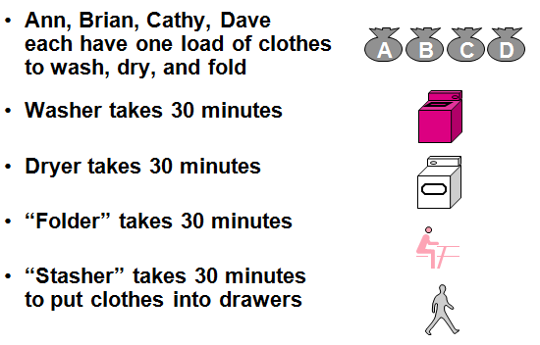
A Laundry Analogy

Slide 6
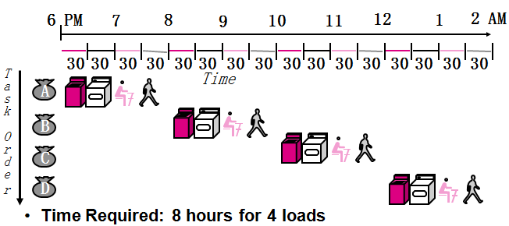
If we do laundry sequentially

Slide 7
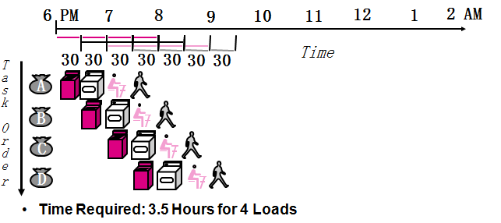
To Pipeline, We Overlap Tasks

Slide 8
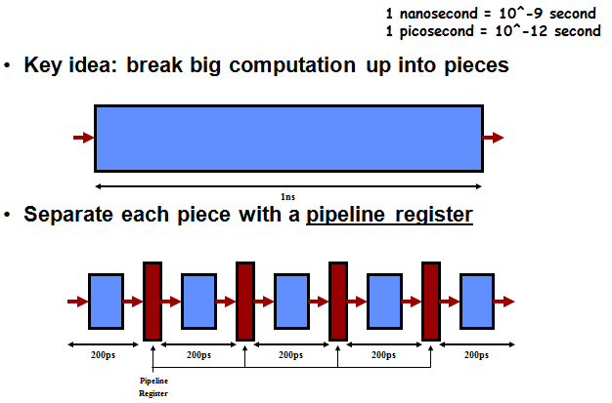
Pipelining A Digital System

Slide 9
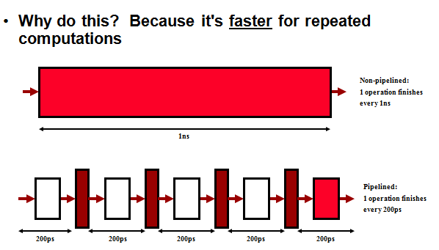
Pipelining A Digital System

Slide 10
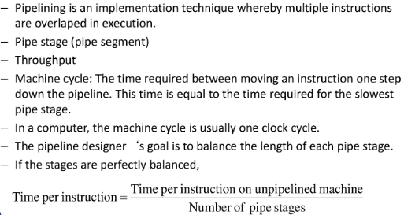
Pipelining

Slide 11
https://youtu.be/coJOhir2aok
THANKS

